Slide 1






TETU APP
DolphinGroup
Note-taking, reading & resource management solution
Pitch Deck

Slide 2
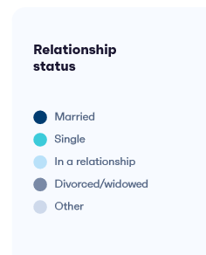


AGENDA
MEET THE TEAM
Team member
Spirit & culture
Our ‘startup’
Overview information
Vision & Mission
Problems & Solutions
Current context & difficulties
view information
What are we going to do?

Slide 3

Executive summary
Problem
Read lots of separate resources
Inefficient note-taking and resources organization
Lack of personalization
Difficulties when reviewing those notes
Target audience
High school/university student
Office worker
Learner
Age: Gen Z – Gen Y
Hobbies: learning, reading, researching
Solution
A hybrid-app can:
+ Read document file and take note in app
+ Organize notes in a structured and coherent manner
+ Create personal notebook to review, track progress and measure results
USP
Built-in note taking and intelligent organizing system
Integration with other tool
Less time-consuming for management
Goal
Positively impact people's behavior and study habits
Improve individual’s productivity, make learning effortless
Become top effective working and learning solution-providers

Slide 4




Our team
Dang Loc CEO - Project Manager
Phuoc Tung CTO
Quoc Tuan Developer
Leadership & technical skill
Planning, coordinate
Communicate between tech and non-tech
Strong IT background
Full-stack developer
Responsible for leading & building final product
Full-stack developer
Expertise in business logic/rules
Wide knowledge of tech-stack

Slide 5



Our team
Vi Khang Developer
Thu Huong Marketing executor, Business planner
Vi Triet Product Designer
Execellent techinical skill
Experiences from international competition
Major in SE/AI/DS
Conduct market research
Planning for business and marketing
Financial management
Responsible for all kind of visual of the project
Work relate to UI/UX

Slide 6
Team’s spirit & culture
Innovate
Enjoy
Compact
ICARE
Reliable
Active

Slide 7




Introduce our startup
Brand
DolphinGroup
Product
Tagline
Knowledge at fingertips
Keyword (criteria)
Lean, Rapid, Personalized, Convenient
God of the knowledge, wisdom, writing, science in ancient Egyptian mythology
Strategy
Customer-centric
Tetu is a comprehensive learning tool that caters to individuals of all ages and backgrounds. With its innovative technology and engaging content, Tetu aims to transform the learning experience for its users.

Slide 8
Vision & Mission
Our Vision
Positively impact people's behavior and study habits, and become top providers of effective working and learning digital solutions.
Our Mission
To mpower the "rapid and lean" concept; To provide a comprehensive and user-friendly learning platform, Tetu, that incorporates innovative technology, interactive features, and engaging content to enhance the learning experience and foster continuous development.

Slide 9
Problems
“
Many documents are in the form of digital asset
Read lots of separate resources to get deeper understanding or find ideas
Diffuse ways of learning language through articles/news
Demand to take note and easily review
”
Inefficient note-taking and organization
Read file in one app and take note in another app, notes are stored distributedly
Lack of a personalized learning experience
Resources is unsynchronous make learning process cannot meet user needs
Time-consuming and boring learning process
Spend lots of time to figure out how to manage learning material
Inability to track progress and measure results
Traditional way of lesson reviewing make it hard to evaluate learning journey

Slide 10

Solutions
Build a cross-platform app that is able to:
Read a document file format like PDF/HTML/markdown/epub
Directly take note in app with powerful text editor
Organize note in a structured and synchronous manner
Intergrate with other resource management tool like Notion
Quickly learn a word/collocation/idiom in the passages
Put notes/words in a dictionary/notebook/card for further revision
Target audience
Satisfy the criteria
High school/university student
Office worker
Learner
Age: Gen Z – Gen Y
Convenient
Personalized
Rapid
Lean

Slide 11
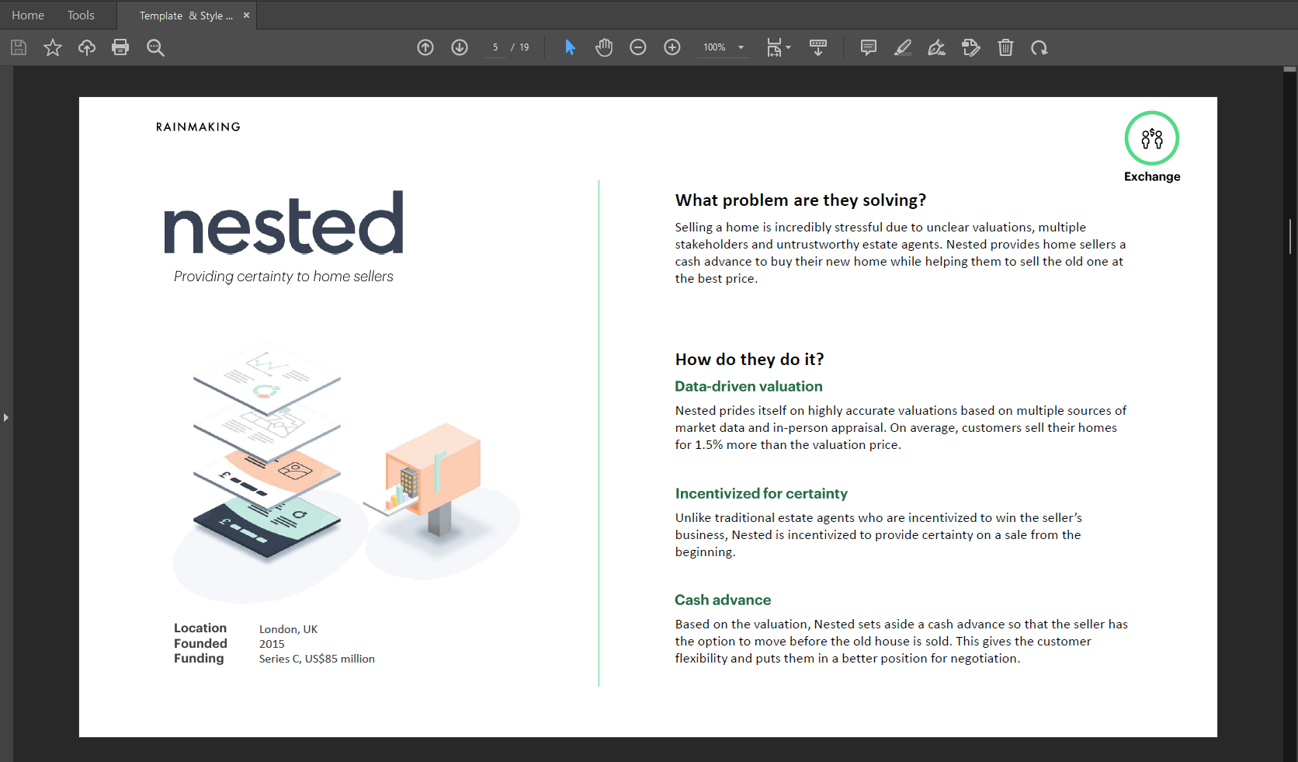
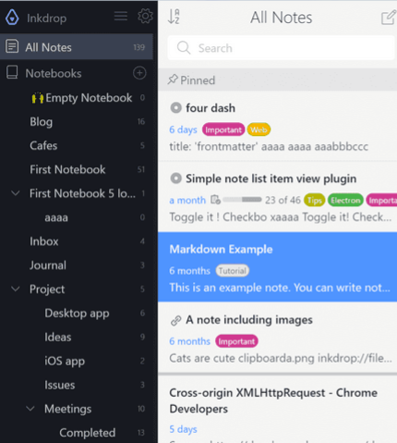
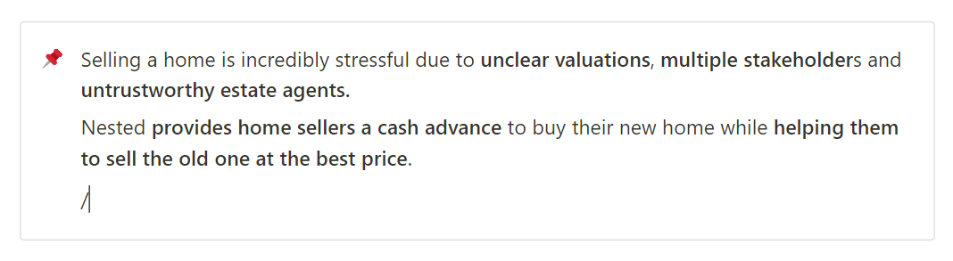

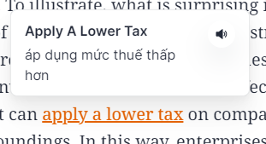
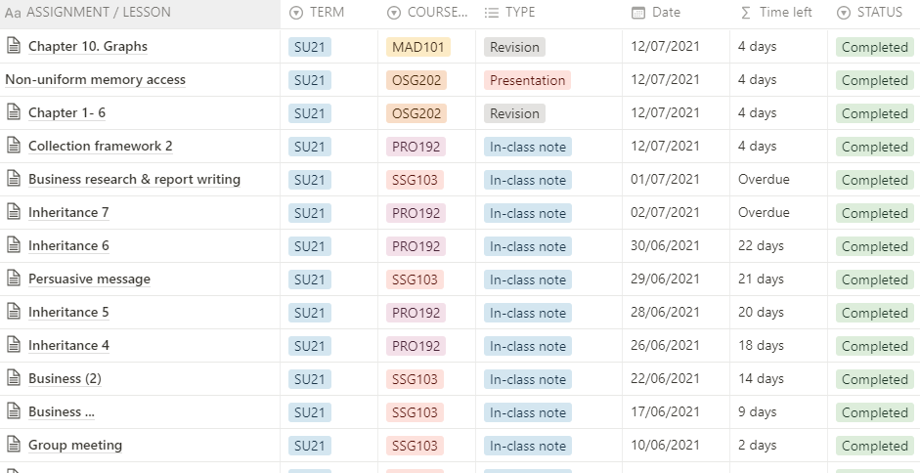
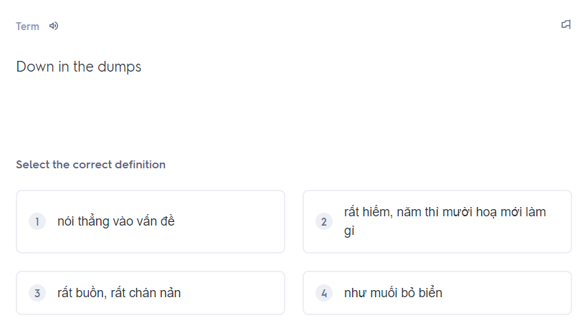
Moodboard
1. Read document files
2. Take note in app
3. Organize user’s notes
6. Store vocabs and revision
5. Learn a vocab
4. Intergrate with other tools

Slide 12
Market research
DolphinGroup

Slide 13
AGENDA
SURVEY REPORT
Summary
Hightlight insights
Preliminary conclusions
MARKET UNDERSTANDING
Overview
Market trend
Customer Segmentation
COMPETITORS
Conclusions
SWOT analysis

Slide 14




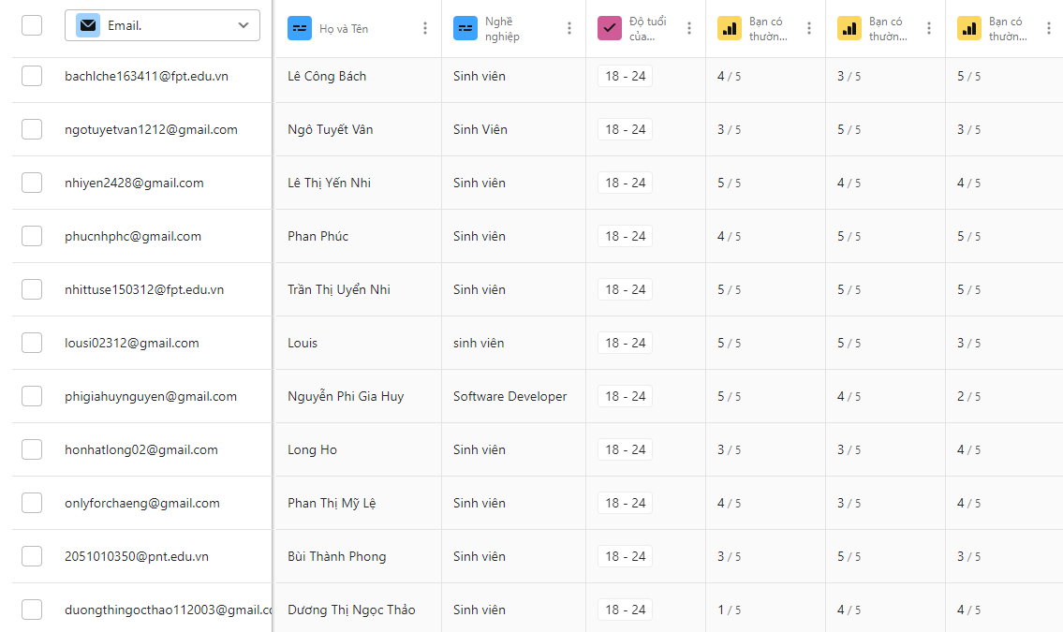
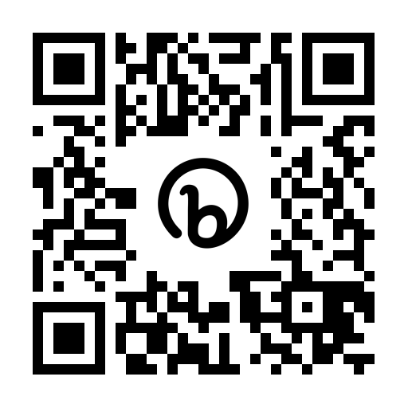
Survey report
Total views
Total Submissions
Valid Submissions
Completion rate
314
126
116
58.6%
bit.ly/tetu_report

Slide 15
Align with the former stated context & problems
Traditional
5.2%
Digital
22.4%
Hybrid
72.4%
Note-taking demand
Feeling overwhelmed
Note-taking habits & overwhelming information problems
Note-taking methods
- Tetu survey report

Slide 16
40.9% and 32.8% for interested and very interested
Self-assessment of process effectiveness
4.0
3.3
5
5
Interest of effective learning process
Average personal
effective score
4.2
Top 3 difficulties
5
Lots of movement and devices to deal with
46.6%
Managing and retrieving notes
44%
Lack of formatting and visualizing abilities in notes
42.2%
The need of a truly optimal solution
to support the learning process
- Tetu survey report

Slide 17
Brand awareness in the related domains
1 - Don't know, don't use
3 - Know, rarely use
5 - Know, generally use
 | 1 | 2 | 3 | 4 | 5
Notion | 18.6% | 7.6% | 29.7% | 14.4% | 29.7%
Evernote | 53.4% | 11% | 27.1% | 6.8% | 1.7%
Obsidian | 65.3% | 11% | 16.1% | 6.8% | 0.8%
OneNote | 18.6% | 11.9% | 39.8% | 16.9% | 12.7%
AppleNotes | 33.1% | 8.5% | 27.1% | 20.3% | 11%
GoogleKeep | 30.5% | 7.6% | 25.4% | 24.6% | 11.9%

Slide 18






Preliminary conclusion
Extensively reading and jotting down
Leverage both physical and digital method
Great interest in personal productivity
“
Avid learners with balanced note-taking methods
and moderate-high interest.
Demand for a all-in-one yet simple solution
Impact factors when choosing an app
User interface
”
Synchrony, connectivity
Cost
Personalization
Organization level

Slide 19




Customer understanding
Behaviours
Regularly read books, do research on a topic, and make notes.
Use pdf reader software on your computer and make notes in Word
Difficulties
Have to tab back and forth
Manage pages
Many many distributed notes
Mrs. Minh Hue Ng
FPT University lecturer
Needs
Ho Chi Minh City
- Ability to work offline of document management applications, automatically syncing when connected
- If highlighted, it will save the page number, author and book information
Master in Theory and History of Art- HCM University of Fine Art
“I want an app that can take notes directly on a pdf and then output a summary page.”

Slide 20


Customer understanding
Behaviours
Often read specialized material provided by the instructor, which can be hundreds or thousands of pages.
Use tablet to read the file and make notes directly on it
Difficulties
Lots of resource and files to manage
Low speed when taking note by typing
Fucnctionality of her productivity app are quite inconvenient when it come to Macbook, Iphone
Ms. Bich Ngoc
22 year-olds
Needs
Former Partnership Intern at Amanotes
- New way to interact and note when she have to use laptop
Miami, USA
Freshman at Miami University
“I feel that the current process is smooth and effective,
I appreciate writing notes by hand whether on paper or on a tablet.”

Slide 21
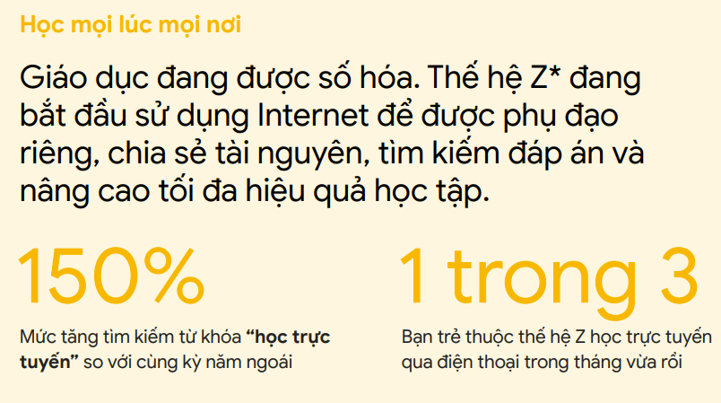
Market understanding
Market size
in US$ Billion
Learning aid
Document reader
Note-taking
Wiki
CAGR 16.4%
Knowledge base platform
Document collaborator
Personal information manager
“A second brain for you, forever”
3.21 (IAP) + 0.15 (Paid app) + 5.91 (Advertising)
Demand-side economy
Key Players
Google (US)
Apple (US)
Microsoft (US)
Evernote (US)
Notion (US)
Milanote (Australia)
Dropbox (US)
Typora (China)
No restrictions on law or government
Global scope development potential
Note Taking App Market - Global Industry Analysis and Forecast (2022-2029) - MMR
Vietnam’s Search for Tomorrow – Google Vietnam

Slide 22






Market trend
Modularize into minor domain
Read
Meeting
Share images
acquired
Business Intelligence

Slide 23










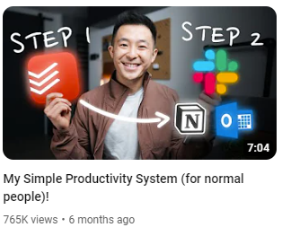


Market trend
Emerging productivity apps
“Time is most precious”
PRODUCTIVITY
The most views and engagement topics on

Slide 24


Market trend
From always-available to pre-planned experiences
Phygital reality
Physical and digital world collide
Craving convenience
Top 10 global consumers trends in 2021 - Euromonitor International

Slide 25

Market demand
Figuring out a workflow
Difficulties in
Working process
Using support tool
They need a solution that
Easy to use, easy to learn
Time efficiency
Cost efficiency
Offline support
Sustainable process

Slide 26

Customer segmentation
Traditional learner
Hobby Learner – 24%
Self-directed learners
High school/University student, 18 – 24 year-olds
Prefer a hybrid method: digital, books, in-person
Passionate for learning in a conventional environment
Career learner – 19%
Prefer reading and listening over group study
Multigenerational learners
Prefer learning through digital
Reluctant Learner – 17%
25%
Have little passion for learning
Skeptical learner - 15%
Don’t think that school is for them
Traditional and Career learners are potential customers
- Pearson -

Slide 27




Customer segmentation
Behaviours
The architect
The gardener
The librarian
The painter
Customization
Build their own
Love discovering
Connect ideas
Arrange neatly
Store & find later
Random
Quickly jot down
Occupation
Student
Engineer
Office worker
Lecturer
Scientist
Blogger
Writer
Researcher
and so on…
- Blog ThinhVu.com & TuanMon.com -

Slide 28









Competitors Note-taking domain
 | Notion | Obsidian | Evernote | GoodNotes | Tetu
Price | Freemium (8$) | Free | Freemium (1.5$) | $7.99 | Freemium (1.5$)
Market share | 73.48% | - | 0.5% | - | -
Platform
Offline support
Markdown support
Organization level | High, linear | High, non-linear | Limited, linear | Medium, linear | High, non-linear
Customization level | High | High | Low | Medium | High
Total visits | 429.3M | 4.0M | 28.3M | 1.4M | -
Community | 1M+ | 100K+ | 706K+ | - | -
- SimilarWebs.com -

Slide 29



Competitor
Learning by reading domain
 | eJOY | News in Level | Lingua Notes | Tetu
Price | Freemium (7$) | Free | Freemium (3$) | Freemium (1.5$)
Platform
Features | - Look up new words while reading - Audio reader - Access to latest news - Paragraph translation | - Read news everyday and learn new words - Review vocab | - Create note - Translate - Create exercise from note | - Read articles/news - Learn a word/grammar from paragraph - Create personal dictionary - Build exercise/flash card for revision
However, these apps lack connectivity to the note taking tool and only solve a micro problem of users

Slide 30
SWOT analysis
Strengths | Weakness
- New, unique idea, meeting a popular painpoint today - Productivity topic is getting more and more popular - Many sample business model/apps for research and reference | - Limited technical expertise to implement - Lack of connections with industry experts
Oppounities | Threats
- Innovation trend is being promoted by the state and enterprises - Global product potential - Strong market demand for personal work solutions | - Many users have formed habits and are loyal to a number of previous appa - The user community of exist apps are substantial and devoted
Focus on our USP and utilize digital marketing to spread quickly at the initial stage.

Slide 31
Business Model Canvas & Product Prototype
DolphinGroup

Slide 32
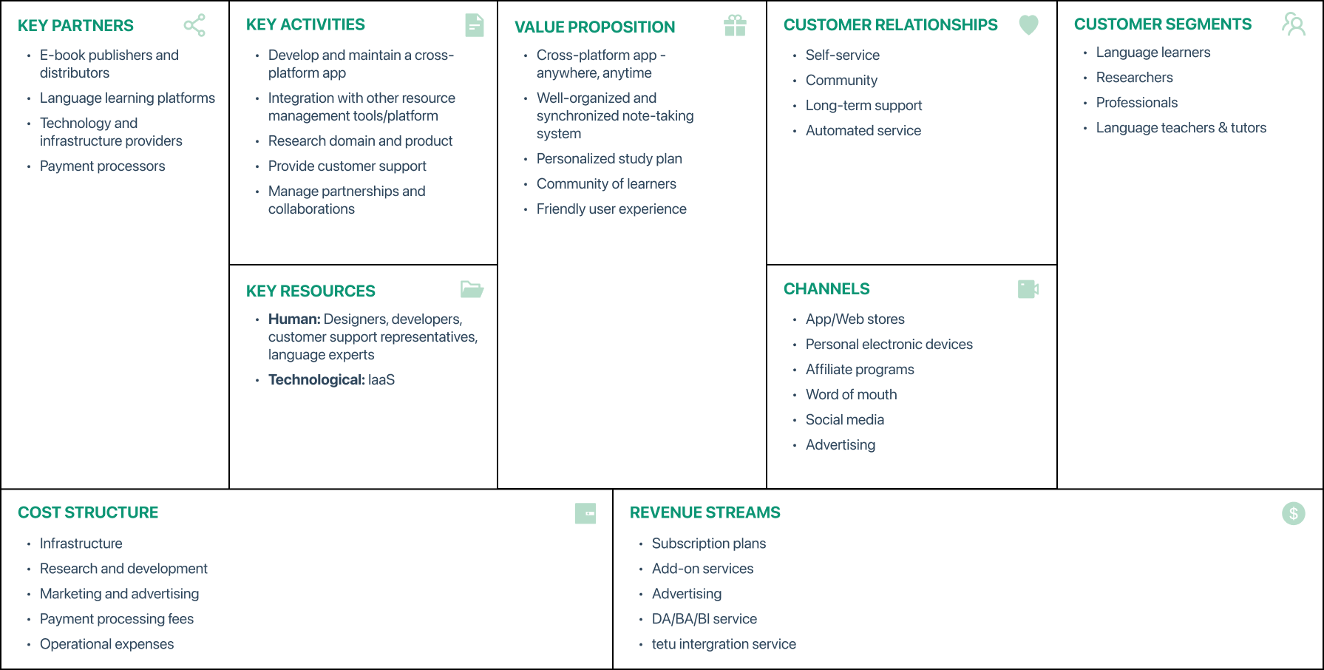
Business model canvas

Slide 33
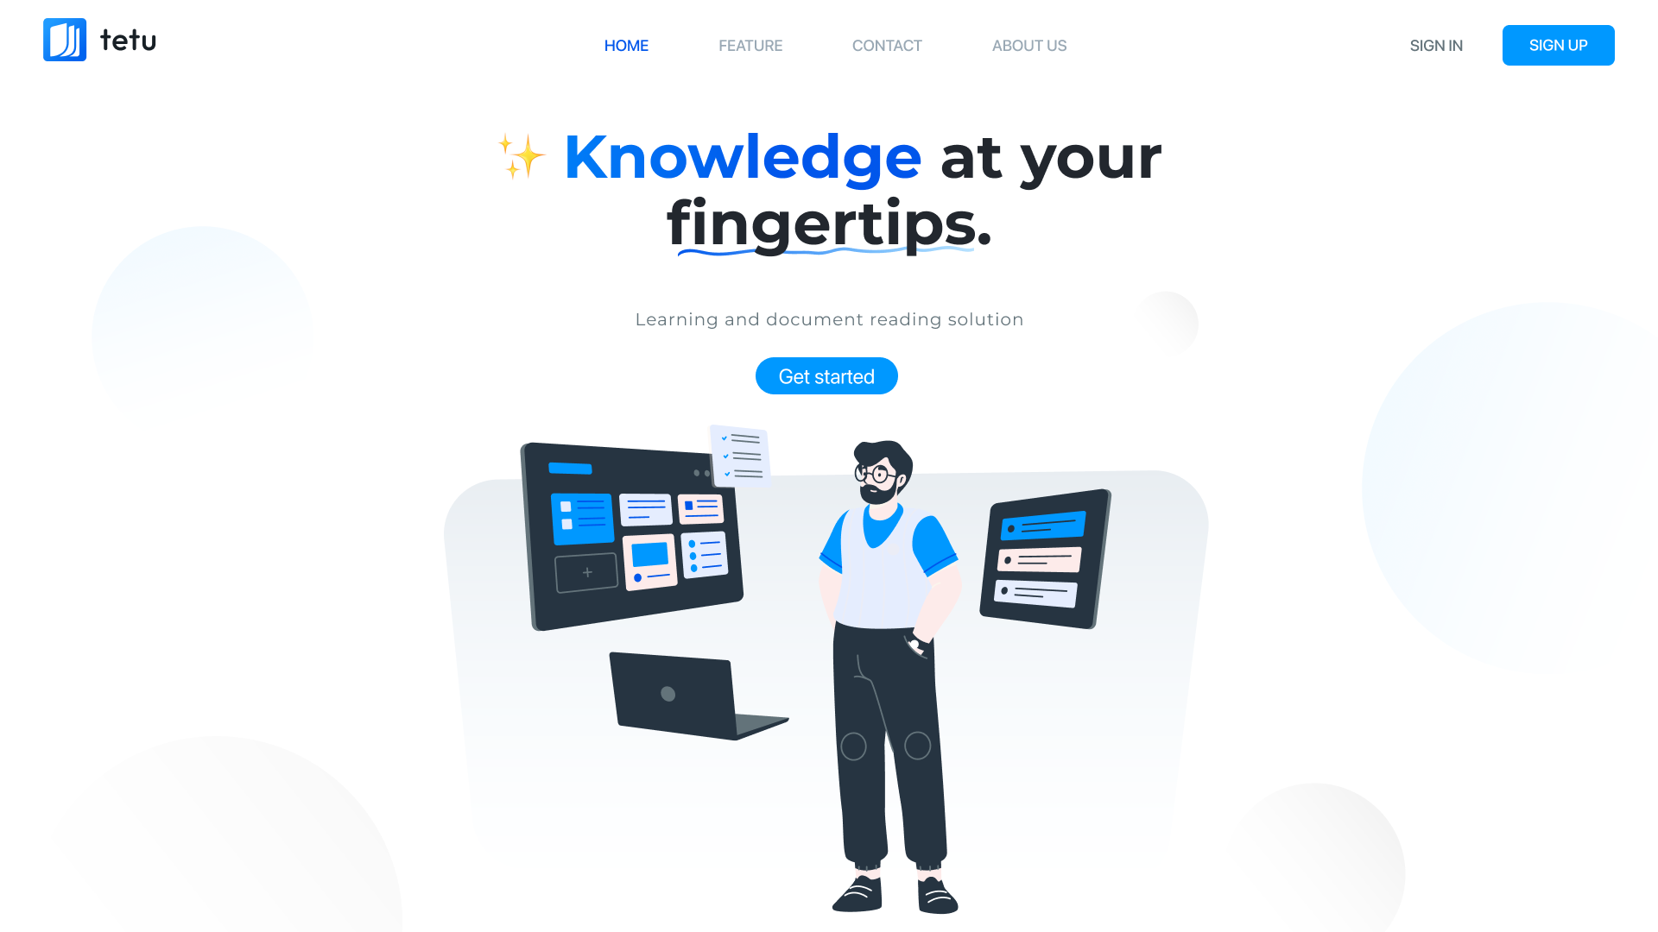
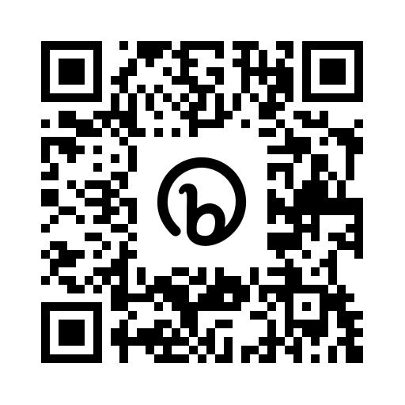
Product Prototype
bit.ly/tetu_app_design

Slide 34
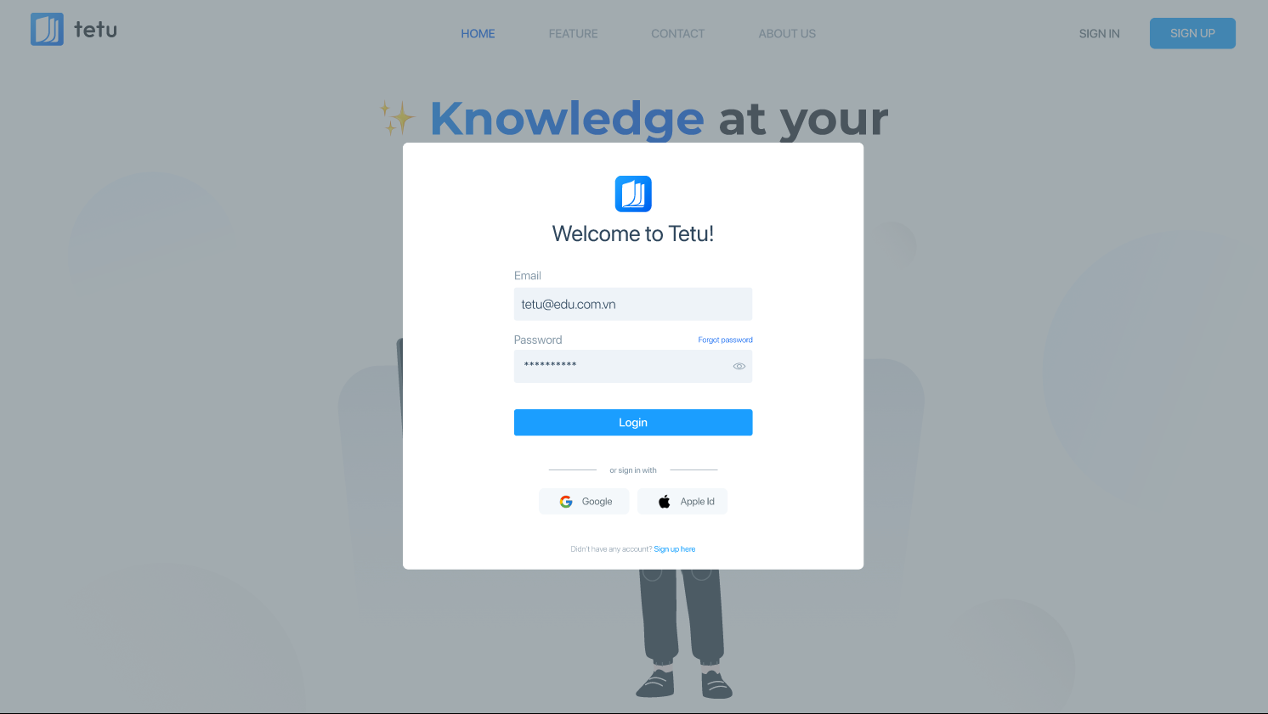
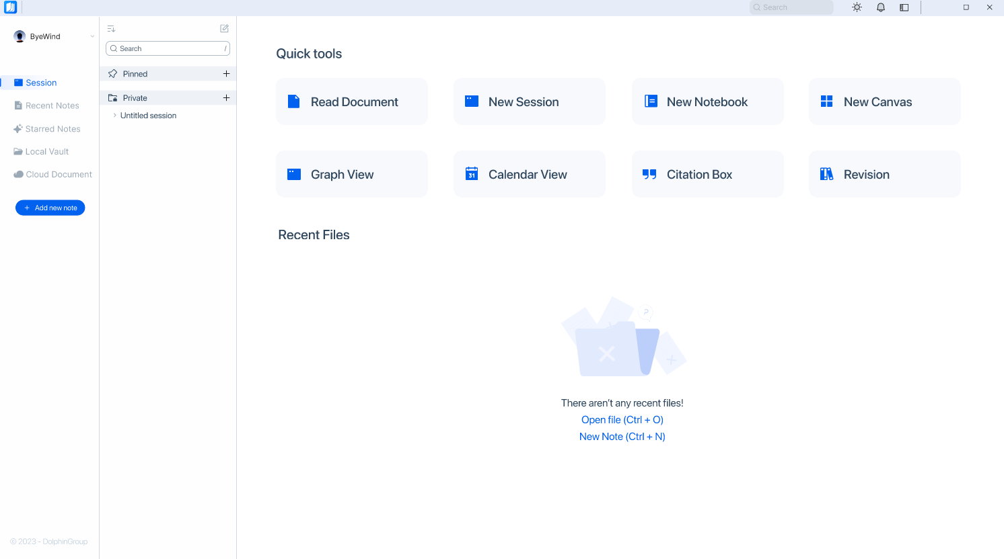
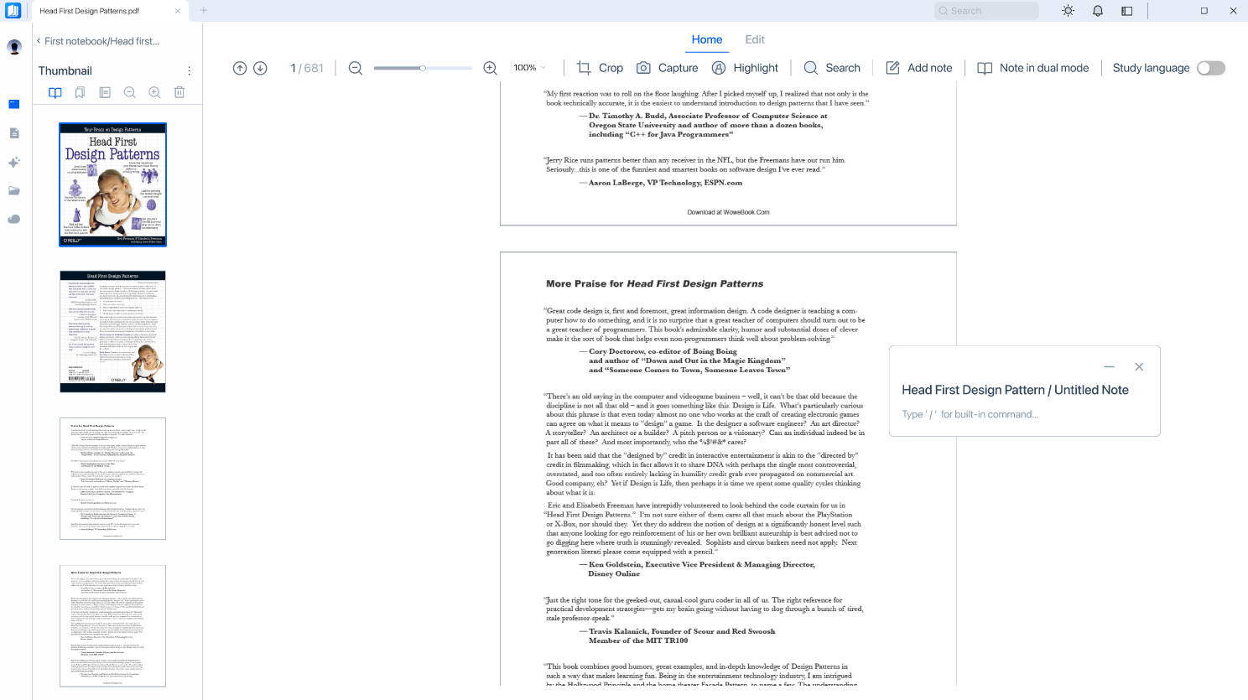
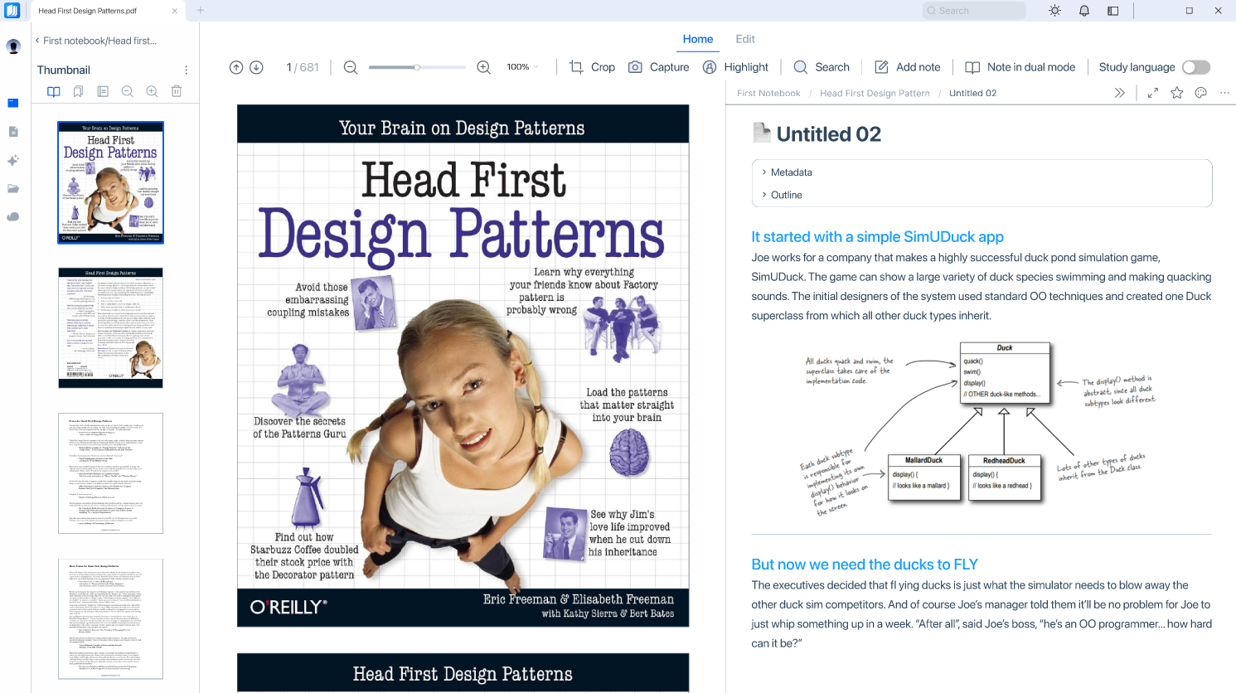
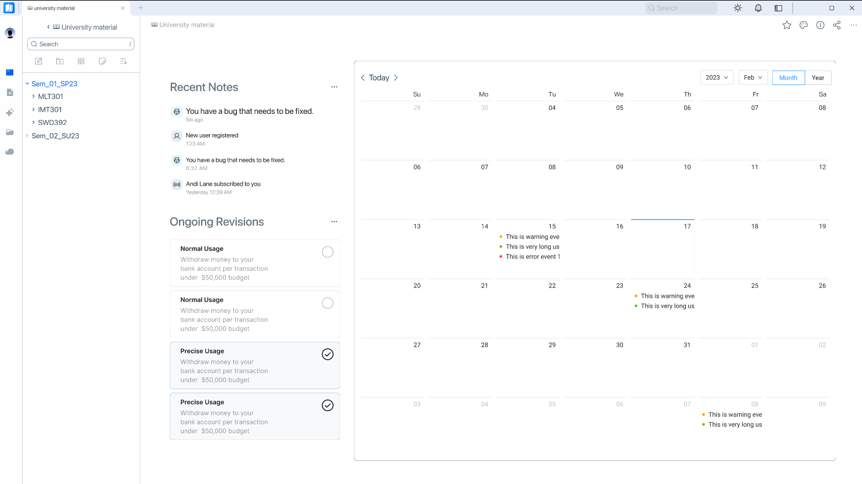
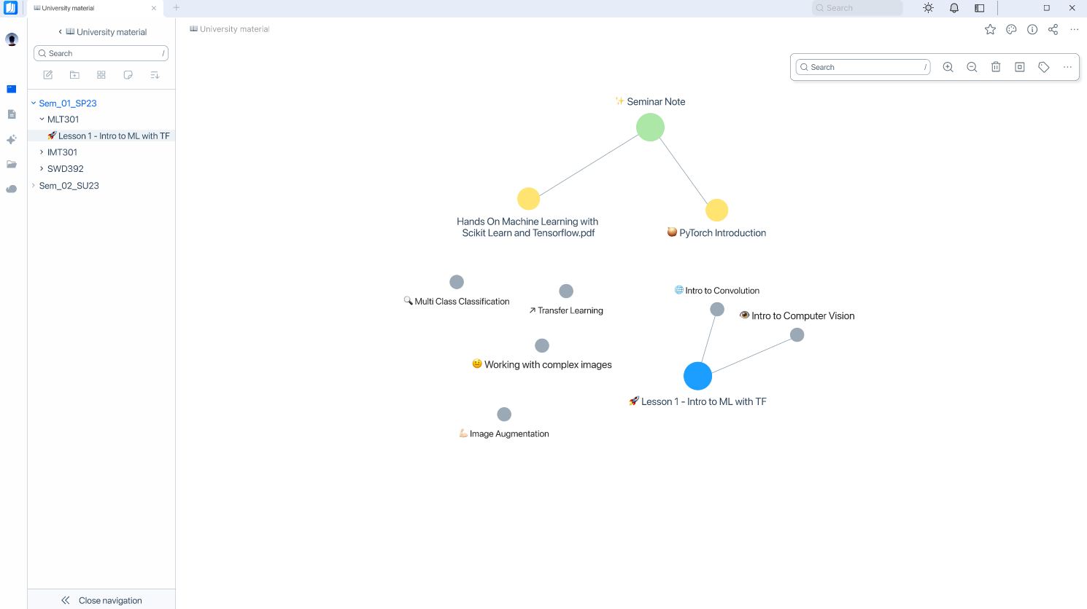
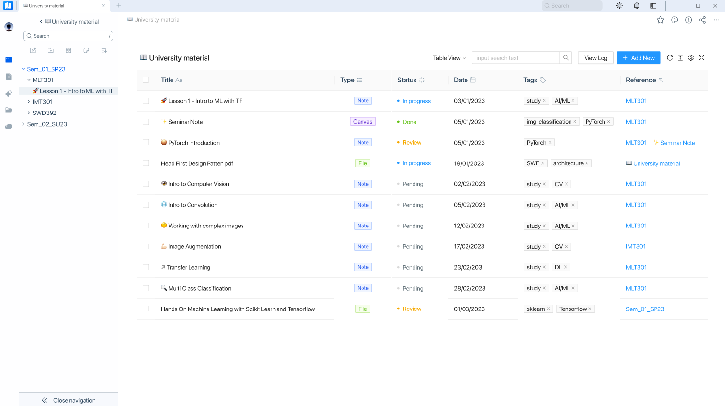
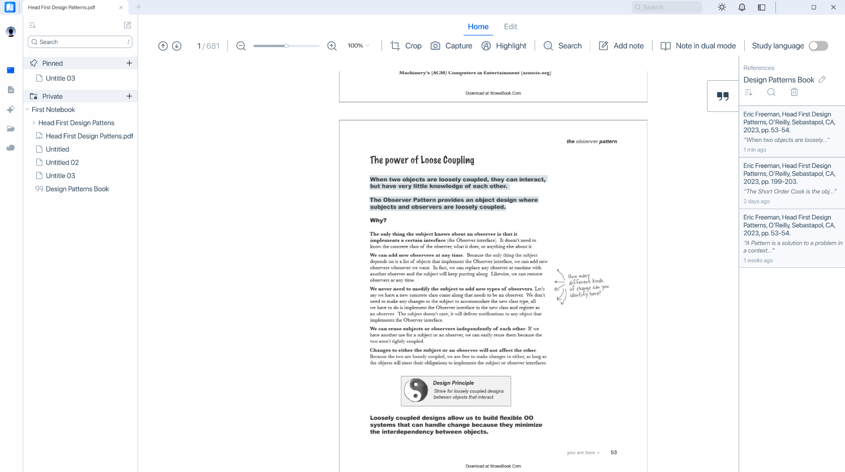
Main flows
Read document and take note
Login
Homepage
Note on-the-fly
Dual-mode note
Calendar-view mode
Graph-view mode
Table-view mode
Citation

Slide 35
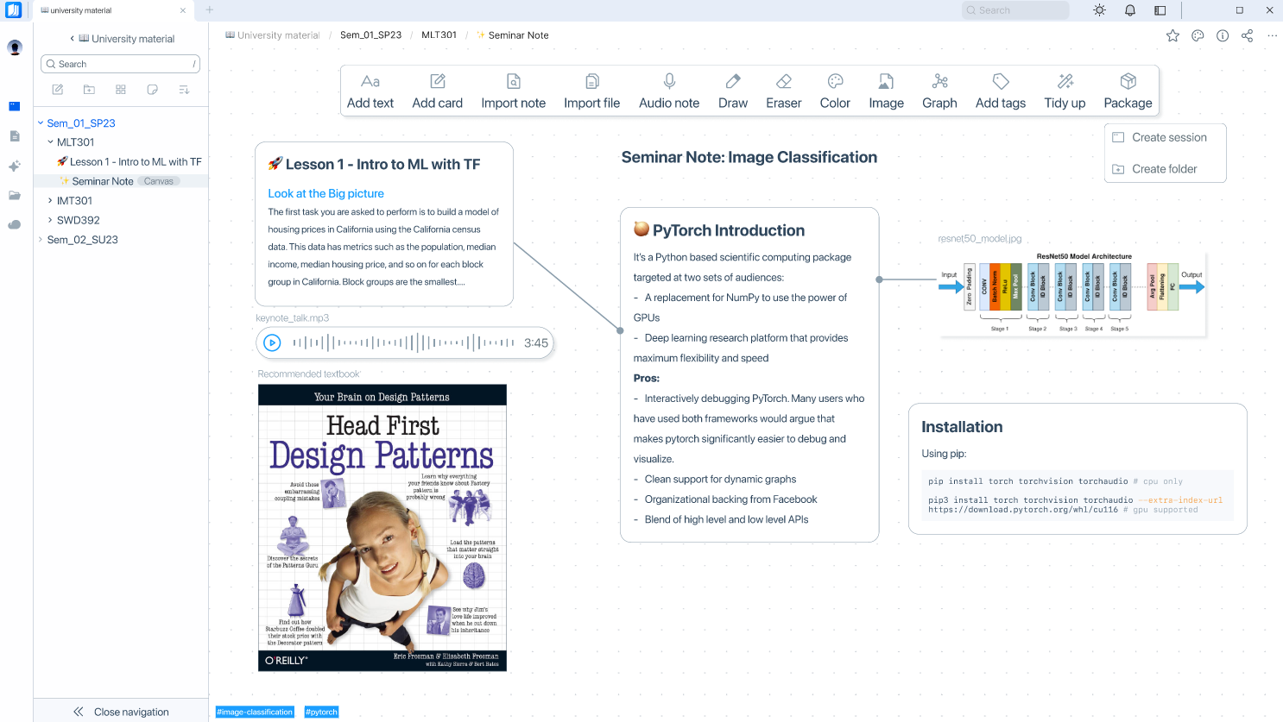
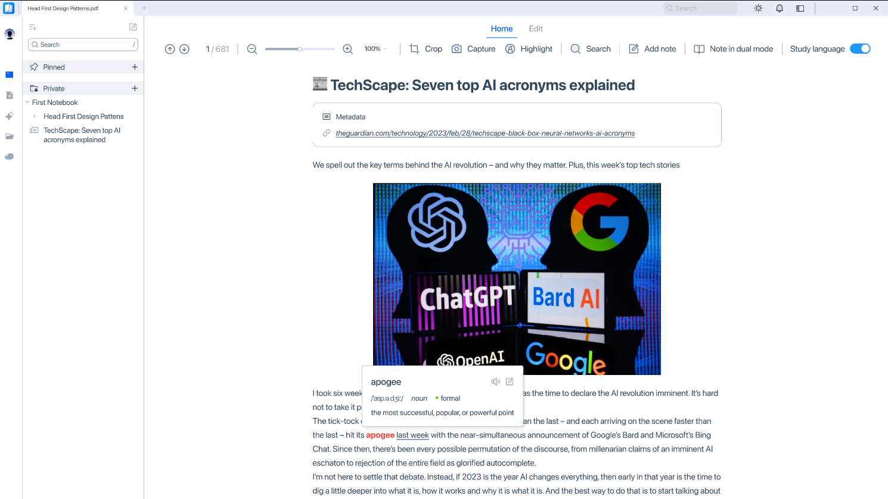
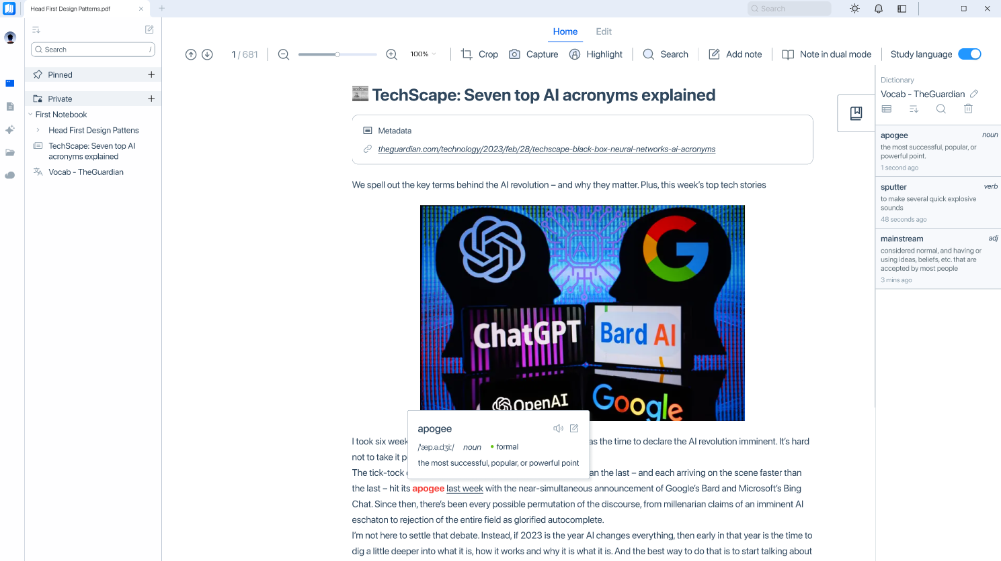
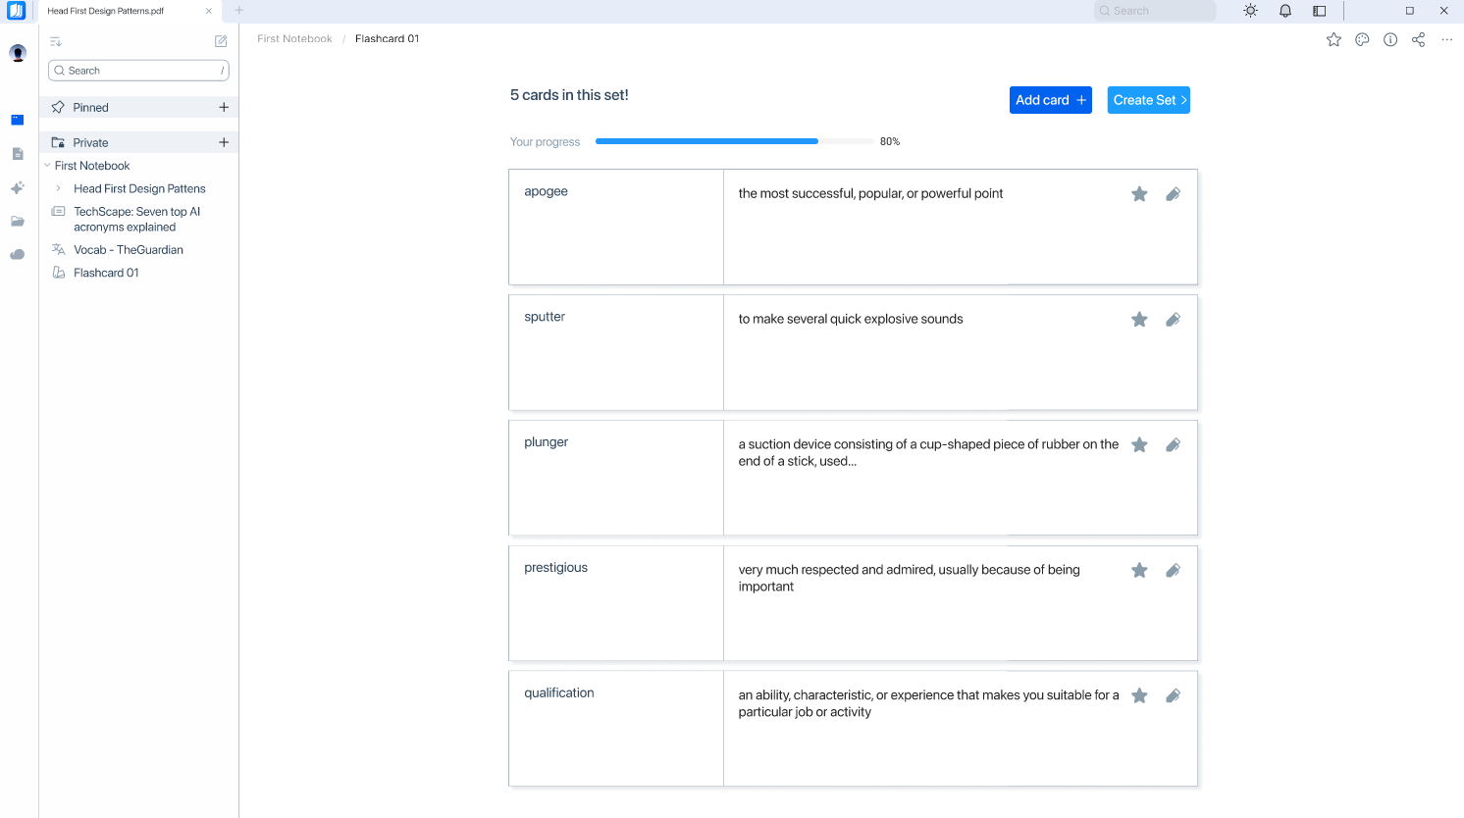
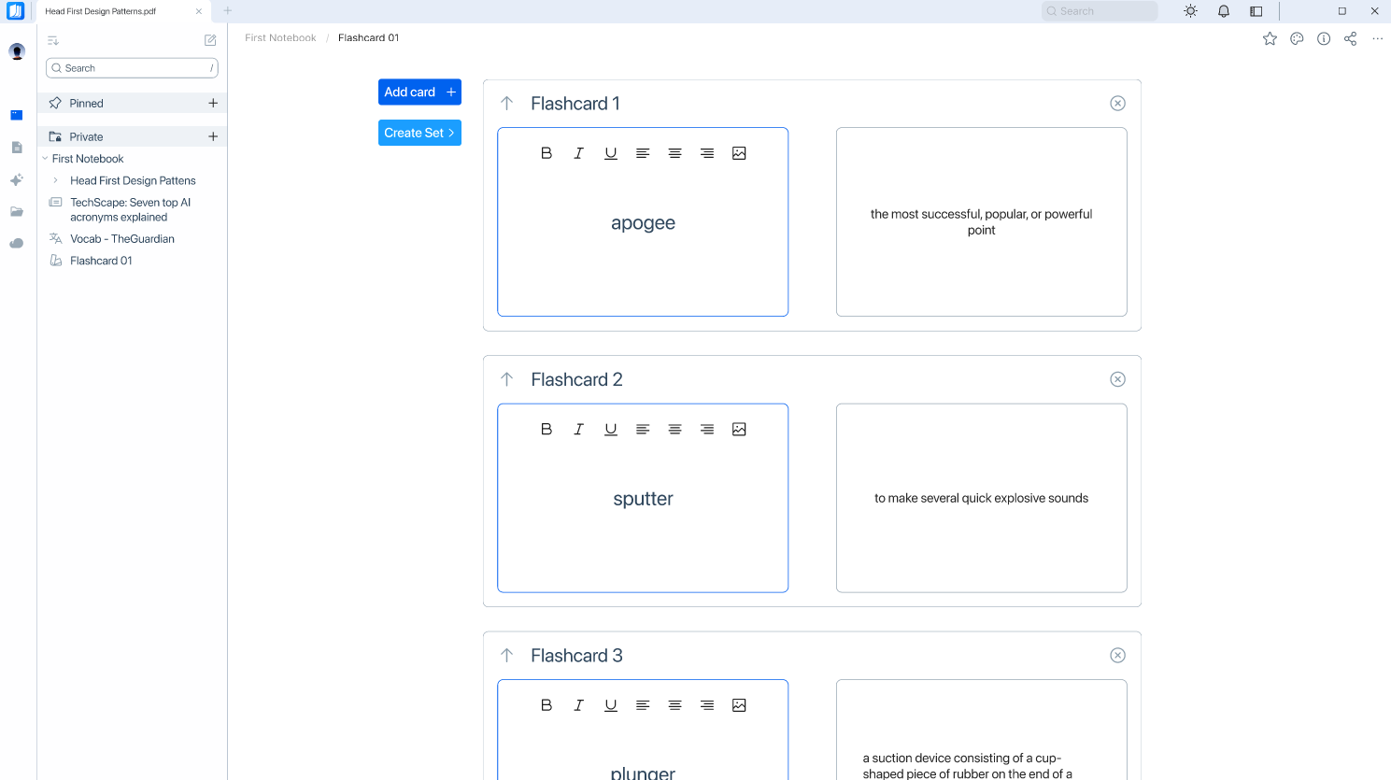
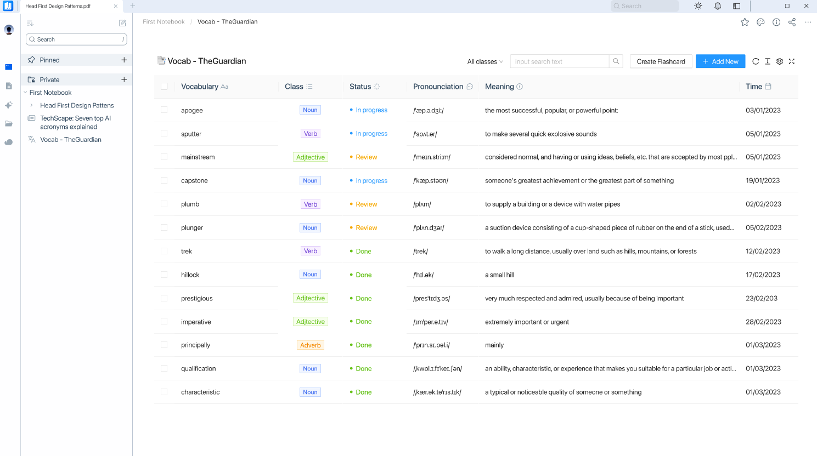
Main flows
Canvas view. Read articles and learn languages
Canvas View
Read online articles
Learn words, put into notebook
Create learning session
Turn into flashcard
Word list (table view)

Slide 36
Business Forecast & Fundraising
DolphinGroup

Slide 37
AGENDA
BUSINESS FORECAST
2023 forecast
2024 forecast
2025 forecast
Consolidation
FUNDRASING
Case study
Startup valuation
Capital plan

Slide 38
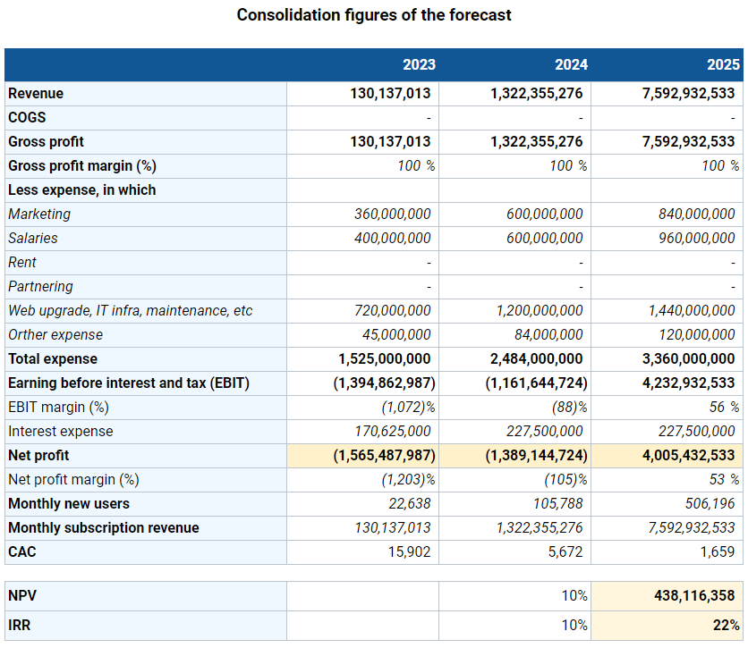
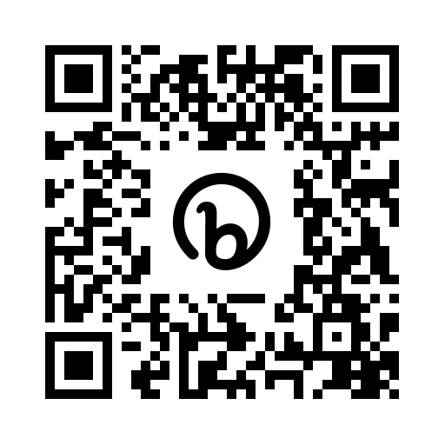
References
Type the url or scan this QR to access the sheets
bit.ly/tetu_biz_forecast

Slide 39
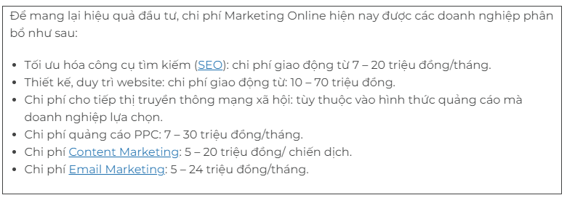

Expense refs
Marketing expenses
gobrading.com
IT infrastructure expense
AWS services pricing plan

Slide 40
Assumptions for 2023
Total loans | 3,500,000,000đ
Interest rate (yearly) | 6.5%
Total monthly salary | 30%
Total monthly marketing | 20%
Total partnering expense | 0%
Web/app upgrading, IT support, maintenance, etc. | 40%
Other expenses | 10%
Refer to BIDV's business loan interest rate
AWS service fees and deployment fees

Slide 41
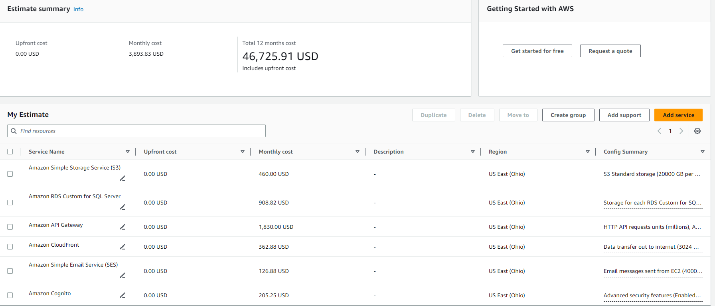
Assumptions for 2023
IT infrastructure expenses

Slide 42
Forecast for 2023
 | Apr-23 | May-23 | Jun-23 | Jul-23 | Aug-23 | Sep-23 | Oct-23 | Nov-23 | Dec-23 | Total
Revenue | - | - | - | - | - | 27,030,487 | 30,409,298 | 34,210,460 | 38,486,768 | 130,137,013
COGS | - | - | - | - | - | - | - | - | - | -
Gross profit | - | - | - | - | - | 23,791,613 | 26,646,606 | 29,844,199 | 33,425,503 | 113,707,921
Gross profit margin (%) | 0% | 0% | 0% | 0% | 0% | 100% | 100% | 100% | 100% | 100%
Less expense, in which
Marketing | 40,000,000 | 40,000,000 | 40,000,000 | 40,000,000 | 40,000,000 | 40,000,000 | 40,000,000 | 40,000,000 | 40,000,000 | 360,000,000
Salaries | 40,000,000 | 40,000,000 | 40,000,000 | 40,000,000 | 40,000,000 | 50,000,000 | 50,000,000 | 50,000,000 | 50,000,000 | 400,000,000
Rent | - | - | - | - | - | - | - | - | - | -
Partnering | - | - | - | - | - | - | - | - | - | -
IT infra, maintenance, etc. | 80,000,000 | 80,000,000 | 80,000,000 | 80,000,000 | 80,000,000 | 80,000,000 | 80,000,000 | 80,000,000 | 80,000,000 | 720,000,000
Other expenses | 5,000,000 | 5,000,000 | 5,000,000 | 5,000,000 | 5,000,000 | 5,000,000 | 5,000,000 | 5,000,000 | 5,000,000 | 45,000,000
Total expenses | 165,000,000 | 165,000,000 | 165,000,000 | 165,000,000 | 165,000,000 | 175,000,000 | 175,000,000 | 175,000,000 | 175,000,000 | 1,525,000,000
EBIT | (165,000,000) | (165,000,000) | (165,000,000) | (165,000,000) | (165,000,000) | (147,969,513) | (144,590,702) | (140,789,540) | (136,513,232) | (1,394,862,987)
EBIT margin (%) | - | - | - | - | - | (547)% | (475)% | (412)% | (355)% | (1,072)%
Interest expenses | 18,958,333 | 18,958,333 | 18,958,333 | 18,958,333 | 18,958,333 | 18,958,333 | 18,958,333 | 18,958,333 | 18,958,333 | 170,625,000
Net profit | (183,958,333) | (183,958,333) | (183,958,333) | (183,958,333) | (183,958,333) | (166,927,846) | (163,549,035) | (159,747,873) | (155,471,566) | (1,565,487,987)
Net profit margin (%) | - | - | - | - | - | (618)% | (538)% | (467)% | (404)% | (1,203)%
Monthly users’ growth rate | 12.5%
New users/month | 1,500 | 1,688 | 1,898 | 2,136 | 2,403 | 2,703 | 3,041 | 3,421 | 3,849 | 22,638
Net accumulative users |  | 3,188 | 5,086 | 7,222 | 9,624 | 12,327 | 15,368 | 18,789 | 22,638
Monthly fees/user | - | - | - | - | - | 10,000 | 10,000 | 10,000 | 10,000 | 40,000
Monthly subscription revenue | - | - | - | - | - | 27,030,487 | 30,409,298 | 34,210,460 | 38,486,768 | 130,137,013
Other revenues | - | - | - | - | - | - | - | - | - | -
Total revenue | - | - | - | - | - | 27,030,487 | 30,409,298 | 34,210,460 | 38,486,768 | 130,137,013

Slide 43

Assumptions for 2024
Total loans | 3,500,000,000đ
Interest rate (yearly) | 6.5%
Total monthly salary | 25%
Total monthly marketing | 25%
Total partnering expense | 0%
Web/app upgrading, IT support, maintenance, etc. | 40%
Other expenses | 10%
Additional loans
0đ
Meeting & sharing event, coworking space, bonding activities, etc.

Slide 44
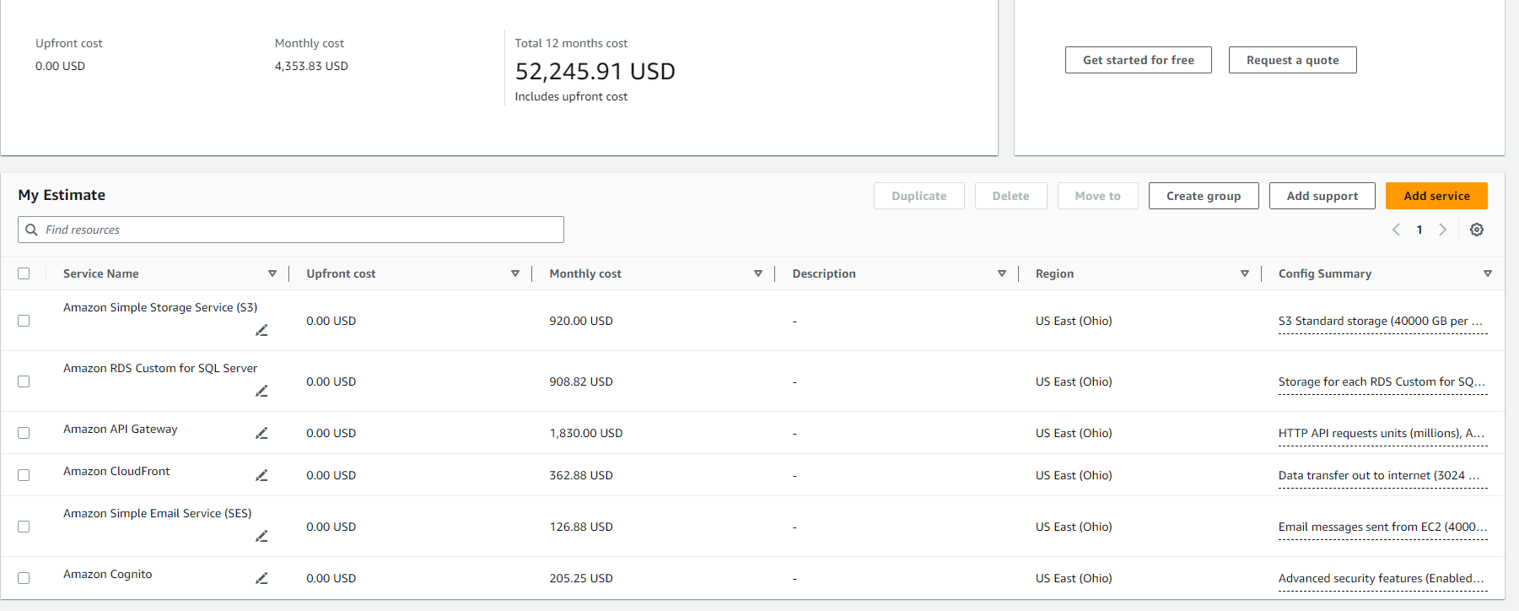
Assumptions for 2024
IT infrastructure expenses

Slide 45
Forecast for 2024
 | Jan-24 | Feb-24 | Mar-24 | Apr-24 | May-24 | Jun-24 | Jul-24 | Aug-24 | Sep-24 | Oct-24 | Nov-24 | Dec-24 | Total
Revenue | 50,000,000 | 56,750,000 | 64,411,250 | 73,106,769 | 82,976,183 | 94,177,967 | 106,891,993 | 121,322,412 | 137,700,937 | 156,290,564 | 177,389,790 | 201,337,412 | 1,322,355,276
COGS | - | - | - | - | - | - | - | - | - | - | - | - | -
Gross profit | 50,000,000 | 56,750,000 | 64,411,250 | 73,106,769 | 82,976,183 | 94,177,967 | 106,891,993 | 121,322,412 | 137,700,937 | 156,290,564 | 177,389,790 | 201,337,412 | 1,322,355,276
Gross profit margin (%) | 100.0% | 100.0% | 100.0% | 100.0% | 100.0% | 100.0% | 100.0% | 100.0% | 100.0% | 100.0% | 100.0% | 100.0% | 100%
Less expenses, in which
Marketing | 50,000,000 | 50,000,000 | 50,000,000 | 50,000,000 | 50,000,000 | 50,000,000 | 50,000,000 | 50,000,000 | 50,000,000 | 50,000,000 | 50,000,000 | 50,000,000 | 600,000,000
Salaries | 50,000,000 | 50,000,000 | 50,000,000 | 50,000,000 | 50,000,000 | 50,000,000 | 50,000,000 | 50,000,000 | 50,000,000 | 50,000,000 | 50,000,000 | 50,000,000 | 600,000,000
Rent | - | - | - | - | - | - | - | - | - | - | - | - | -
Partnering | - | - | - | - | - | - | - | - | - | - | - | - | -
IT infra, maintenance, etc. | 100,000,000 | 100,000,000 | 100,000,000 | 100,000,000 | 100,000,000 | 100,000,000 | 100,000,000 | 100,000,000 | 100,000,000 | 100,000,000 | 100,000,000 | 100,000,000 | 1,200,000,000
Other expenses | 7,000,000 | 7,000,000 | 7,000,000 | 7,000,000 | 7,000,000 | 7,000,000 | 7,000,000 | 7,000,000 | 7,000,000 | 7,000,000 | 7,000,000 | 7,000,000 | 84,000,000
Total expenses | 207,000,000 | 207,000,000 | 207,000,000 | 207,000,000 | 207,000,000 | 207,000,000 | 207,000,000 | 207,000,000 | 207,000,000 | 207,000,000 | 207,000,000 | 207,000,000 | 2,484,000,000
EBIT | (157,000,000) | (150,250,000) | (142,588,750) | (133,893,231) | (124,023,817) | (112,822,033) | (100,108,007) | (85,677,588) | (69,299,063) | (50,709,436) | (29,610,210) | (5,662,588) | (1,161,644,724)
EBIT margin (%) | (314)% | (265)% | (221)% | (183)% | (149)% | (120)% | (94)% | (71)% | (50)% | (32)% | (17)% | (3)% | (88)%
Interest expenses | 18,958,333 | 18,958,333 | 18,958,333 | 18,958,333 | 18,958,333 | 18,958,333 | 18,958,333 | 18,958,333 | 18,958,333 | 18,958,333 | 18,958,333 | 18,958,333 | 227,500,000
Net profit | (175,958,333) | (169,208,333) | (161,547,083) | (152,851,565) | (142,982,151) | (131,780,366) | (119,066,341) | (104,635,922) | (88,257,396) | (69,667,769) | (48,568,543) | (24,620,922) | (1,389,144,724)
Net profit margin (%) | (352)% | (298)% | (251)% | (209)% | (172)% | (140)% | (111)% | (86)% | (64)% | (45)% | (27)% | (12)% | (105)%
Monthly users' growth rate | 13.5%
New users/month | 4,000 | 4,540 | 5,153 | 5,849 | 6,638 | 7,534 | 8,551 | 9,706 | 11,016 | 12,503 | 14,191 | 16,107 | 105,788
Net accumulative uesrs |  | 8,540 | 13,693 | 19,541 | 26,180 | 33,714 | 42,265 | 51,971 | 62,987 | 75,490 | 89,681 | 105,788
Monthly fees/users | 12,500 | 12,500 | 12,500 | 12,500 | 12,500 | 12,500 | 12,500 | 12,500 | 12,500 | 12,500 | 12,500 | 12,500 | 150,000
Monthly subscription revenue | 50,000,000 | 56,750,000 | 64,411,250 | 73,106,769 | 82,976,183 | 94,177,967 | 106,891,993 | 121,322,412 | 137,700,937 | 156,290,564 | 177,389,790 | 201,337,412 | 1,322,355,276
Other revenues | - | - | - | - | - | - | - | - | - | - | - | - | -
Total revenue | 50,000,000 | 56,750,000 | 64,411,250 | 73,106,769 | 82,976,183 | 94,177,967 | 106,891,993 | 121,322,412 | 137,700,937 | 156,290,564 | 177,389,790 | 201,337,412 | 1,322,355,276

Slide 46
Assumptions for 2025
Total loans | 3,500,000,000đ
Interest rate (yearly) | 6.5%
Total monthly salary | 30%
Total monthly marketing | 20%
Total partnering expense | 0%
Web/app upgrading, IT support, maintenance, etc. | 40%
Other expenses | 10%
Additional loans
0đ
Meeting & sharing event, coworking space, bonding activities, etc.

Slide 47

Assumptions for 2025
IT infrastructure expenses

Slide 48
Forecast for 2025
 | Jan-25 | Feb-25 | Mar-25 | Apr-25 | May-25 | Jun-25 | Jul-25 | Aug-25 | Sep-25 | Oct-25 | Nov-25 | Dec-25 | Total
Revenue | 270,000,000 | 309,150,000 | 353,976,750 | 405,303,379 | 464,072,369 | 531,362,862 | 608,410,477 | 696,629,996 | 797,641,346 | 913,299,341 | 1,045,727,745 | 1,197,358,268 | 7,592,932,533
COGS | - | - | - | - | - | - | - | - | - | - | - | - | -
Gross profit | 270,000,000 | 309,150,000 | 353,976,750 | 405,303,379 | 464,072,369 | 531,362,862 | 608,410,477 | 696,629,996 | 797,641,346 | 913,299,341 | 1,045,727,745 | 1,197,358,268 | 7,592,932,533
Gross profit margin (%) | 100% | 100% | 100% | 100% | 100% | 100% | 100% | 100% | 100% | 100% | 100% | 100% | 100%
Less expenses, in which
Marketing | 70,000,000 | 70,000,000 | 70,000,000 | 70,000,000 | 70,000,000 | 70,000,000 | 70,000,000 | 70,000,000 | 70,000,000 | 70,000,000 | 70,000,000 | 70,000,000 | 840,000,000
Salaries | 80,000,000 | 80,000,000 | 80,000,000 | 80,000,000 | 80,000,000 | 80,000,000 | 80,000,000 | 80,000,000 | 80,000,000 | 80,000,000 | 80,000,000 | 80,000,000 | 960,000,000
Rent | - | - | - | - | - | - | - | - | - | - | - | - | -
Partnering | - | - | - | - | - | - | - | - | - | - | - | - | -
IT infra, maintenance, etc. | 120,000,000 | 120,000,000 | 120,000,000 | 120,000,000 | 120,000,000 | 120,000,000 | 120,000,000 | 120,000,000 | 120,000,000 | 120,000,000 | 120,000,000 | 120,000,000 | 1,440,000,000
Other expenses | 10,000,000 | 10,000,000 | 10,000,000 | 10,000,000 | 10,000,000 | 10,000,000 | 10,000,000 | 10,000,000 | 10,000,000 | 10,000,000 | 10,000,000 | 10,000,000 | 120,000,000
Total expenses | 280,000,000 | 280,000,000 | 280,000,000 | 280,000,000 | 280,000,000 | 280,000,000 | 280,000,000 | 280,000,000 | 280,000,000 | 280,000,000 | 280,000,000 | 280,000,000 | 3,360,000,000
EBIT | (10,000,000) | 29,150,000 | 73,976,750 | 125,303,379 | 184,072,369 | 251,362,862 | 328,410,477 | 416,629,996 | 517,641,346 | 633,299,341 | 765,727,745 | 917,358,268 | 4,232,932,533
EBIT margin (%) | (4)% | 9 % | 21 % | 31 % | 40 % | 47 % | 54 % | 60 % | 65 % | 69 % | 73 % | 77 % | 56 %
Interest expenses | 18,958,333 | 18,958,333 | 18,958,333 | 18,958,333 | 18,958,333 | 18,958,333 | 18,958,333 | 18,958,333 | 18,958,333 | 18,958,333 | 18,958,333 | 18,958,333 | 227,500,000
Net profit | (28,958,333) | 10,191,667 | 55,018,417 | 106,345,045 | 165,114,035 | 232,404,529 | 309,452,144 | 397,671,663 | 498,683,012 | 614,341,008 | 746,769,412 | 898,399,935 | 4,005,432,533
Net profit margin (%) | (11)% | 3 % | 16 % | 26 % | 36 % | 44 % | 51 % | 57 % | 63 % | 67 % | 71 % | 75 % | 53 %
Monthly user' growth rate | 14.5%
New users/month | 18,000 | 20,610 | 23,598 | 27,020 | 30,938 | 35,424 | 40,561 | 46,442 | 53,176 | 60,887 | 69,715 | 79,824 | 506,196
Net accumulative uesrs |  | 36,465 | 58,752 | 84,272 | 113,491 | 146,947 | 185,254 | 229,116 | 279,338 | 336,842 | 402,684 | 478,074
Monthly fees/users | 15,000 | 15,000 | 15,000 | 15,000 | 15,000 | 15,000 | 15,000 | 15,000 | 15,000 | 15,000 | 15,000 | 15,000 | 180,000
Monthly subscription revenue | 270,000,000 | 309,150,000 | 353,976,750 | 405,303,379 | 464,072,369 | 531,362,862 | 608,410,477 | 696,629,996 | 797,641,346 | 913,299,341 | 1,045,727,745 | 1,197,358,268 | 7,592,932,533
Other revenues | - | - | - | - | - | - | - | - | - | - | - | - | -
Total revenue | 270,000,000 | 309,150,000 | 353,976,750 | 405,303,379 | 464,072,369 | 531,362,862 | 608,410,477 | 696,629,996 | 797,641,346 | 913,299,341 | 1,045,727,745 | 1,197,358,268 | 7,592,932,533

Slide 49
Consolidation
 | 2023 | 2024 | 2025
Revenue | 130,137,013 | 1,322,355,276 | 7,592,932,533
COGS | - | - | -
Gross profit | 130,137,013 | 1,322,355,276 | 7,592,932,533
Gross profit margin (%) | 100 % | 100 % | 100 %
Less expense, in which
Marketing | 360,000,000 | 600,000,000 | 840,000,000
Salaries | 400,000,000 | 600,000,000 | 960,000,000
Rent | - | - | -
Partnering | - | - | -
Web upgrade, IT infra, maintenance, etc | 720,000,000 | 1,200,000,000 | 1,440,000,000
Orther expense | 45,000,000 | 84,000,000 | 120,000,000
Total expense | 1,525,000,000 | 2,484,000,000 | 3,360,000,000
EBIT | (1,394,862,987) | (1,161,644,724) | 4,232,932,533
EBIT margin (%) | (1,072)% | (88)% | 56 %
Interest expense | 170,625,000 | 227,500,000 | 227,500,000
Net profit | (1,565,487,987) | (1,389,144,724) | 4,005,432,533
Net profit margin (%) | (1,203)% | (105)% | 53 %
Monthly new users | 22,638 | 105,788 | 506,196
Monthly subscription revenue | 130,137,013 | 1,322,355,276 | 7,592,932,533
CAC | 15,902 | 5,672 | 1,659
NPV |  | 10% | 438,116,358
IRR |  | 10% | 22%
NPV is > 0, IRR > benchmark 10%
Until the end of 2024 will still suffer losses.
Decreasing costs
Increasing revenue, users
Opportunities for development & gain more profit in the next periods

Slide 50


Case study
 | Notion | Evernote | ClickUp
Launch | 2013 | 2008 | 2017
Users | 1M | 500,000 (2009) | 4M (2021)
Revenue | ~ $11M (2019) | $650,000 | $30M
Valuation | $60M | $80M | $200M
Raised | $18.2M (2019) – Series A | $26M (2009) – Series A | $35M (2020) – Series A
Valuation / Revenue | ~ 5.5 times | ~ 12.5 times | ~ 2.67 times
- crunchbase, techcrunch & getlatka -

Slide 51

Startup Valuation
 | ClickUp | Tetu
Launch | 2017 | 2023
Monthly users | over 340k (2021) | Over 70k (2025)
Revenue | $30M | $322,748
Valuation | $200M | $900,000 (~21,303,319,000đ)
Valuation / Revenue | ~ 2.67 times | ~ 3 times
Shares offer
10%
2,100,000,000 VND
(2 billions, one hundred millions dongs)
Compare with ClickUp figures and consider tetu growth rate

Slide 52
Capital plan
Money raised
2,100,000,000đ
Plan for 6 months
Jan – Jun / 2026
 | Weight | Expense | Note
IT infrastructure | 40% | 840,000,000 đ | 100k MAU
Marketing & Customer acquisition | 15% | 315,000,000 đ | Promote digital marketing, ads & KOL booking
Salary | 20% | 420,000,000 đ | Offer competitive salaries to attract and retain talent
Research & development | 10% | 210,000,000 đ | Improve the app's functionality and usability, deveolop advance features
Legal | 5% | 105,000,000 đ | Allocate funds towards hiring legal counsel and consultants
Others | 10% | 210,000,000 đ | Bonding activites, internal events, etc.

Slide 53

THANK YOU!
If you have any questions?
Don’t hesitate to ask us
or contact us
dolphin.team111@gmail.com
DolphinGroup

